Slide 1

19CSE314 Software Engineering
Lecture 4-5

Slide 2
Generic View of the Process
Pressman R S, Bruce R.Maxim, “Software engineering - A Practitioner’s Approach”, Eighth Edition, Tata McGraw-Hill, 2014
Chapter 3: 3.1, 3.2, 3.3, 3.4

Slide 3
Recap
Nature of Software
The Changing Nature of Software
Software Engineering Definition
The Software Process

Slide 4
Recap
Software is the key element in the evolution of computer-based systems and products and one of the most important technologies on the world stage
The nature of software is changing → Web, Mobile, Cloud …
Software engineering encompasses process, methods, and tools that enable complex computer-based systems to be built in a timely manner with quality
The software process incorporates five framework activities — communication, planning, modeling, construction, and deployment—that are applicable to all software projects
Software engineering practice is a problem-solving activity that follows a set of core principles

Slide 5
Topics Covered
Topic | Text Book Reference
Generic Process Model | 3.1
Defining a framework activity | 3.2
Identifying a task set | 3.3
Process Patterns | 3.4

Slide 6
Chapter 3: Software Process Structure

Slide 7
Question
What is a process?

Slide 8
RECAP: Process
A process was defined as a collection of work activities, actions, and tasks that are performed when some work product is to be created
Each of these activities, actions, and tasks resides within a framework or model that defines their relationship with the process and with one another

Slide 9
Question?
Is “process” synonymous with “software engineering”?

Slide 10
Answer
YES and NO
A software process defines the approach that is taken as software is engineered
But software engineering also encompasses technologies that populate the process—technical methods and automated tools
More important, software engineering is performed by creative, knowledgeable people (ALL OF YOU ☺) who should adapt a mature software process so that it is appropriate for the products that they build and the demands of their marketplace

Slide 11
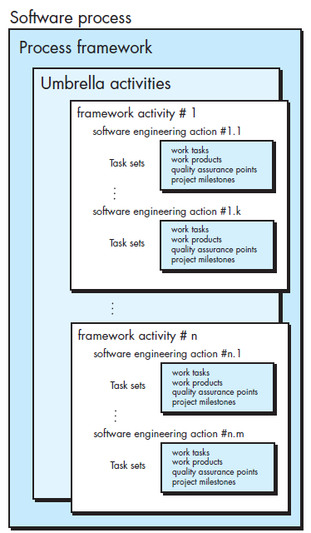
A Software process framework
Each framework activity is populated by a set of software engineering actions
Each software engineering action is defined by a task set that
Identifies the work tasks that are to be completed
The work products that will be produced
The quality assurance points that will be required, and
The milestones that will be used to indicate progress

Slide 12
Question?
A generic process framework for software engineering encompasses five activities. What are they?

Slide 13
RECAP: The Process framework A generic process framework for software engineering encompasses five activities
Communication
Before any technical work can commence, it is critically important to communicate and collaborate with the customer (and other stakeholders)
Planning
Software project plan—defines the software engineering work by describing the technical tasks to be conducted, the risks that are likely, the resources that will be required, the work products to be produced, and a work schedule
Modeling
Create a “sketch” of the thing so that you’ll understand the big picture, what it will look like architecturally, how the constituent parts fi t together, and many other characteristics
The intent is to understand stakeholders’ objectives for the project and to gather requirements that help define software features and functions
Construction
What you design must be built. This activity combines code generation (either manual or automated) and the testing that is required to uncover errors in the code
Deployment
The software (as a complete entity or as a partially completed increment) is delivered to the customer who evaluates the delivered product and provides feedback based on the evaluation

Slide 14
Question?
List typical umbrella activities involved in software engineering

Slide 15
RECAP: Umbrella activities
In general, umbrella activities are applied throughout a software project and help a software team manage and control progress, quality, change, and risk
Typical umbrella activities include
Software project tracking and control
Risk Management
Software Quality Assurance
Technical Reviews
Measurement
Software Configuration Management
Reusability management
Work product preparation and Management

Slide 16
Generic Process Model – Process Flow
All the above framework activities and set of umbrella activities are applied throughout the process
In addition, process flow describes how the framework activities and the actions and tasks that occur within each framework activity are organized with respect to sequence and time

Slide 17

Different types of process flows
Linear process flow
Executes each of the five framework activities in sequence, beginning with communication and culminating with deployment

Slide 18
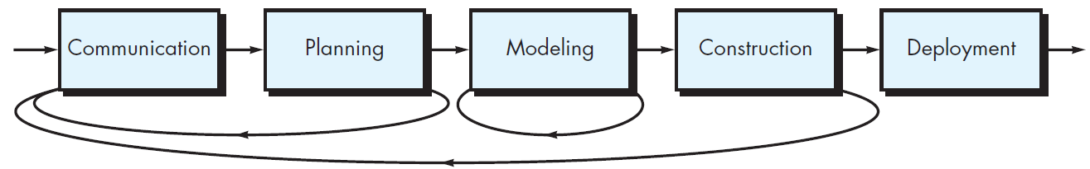
Different types of process flows
Iterative process flow
Repeats one or more of the activities before proceeding to the next

Slide 19
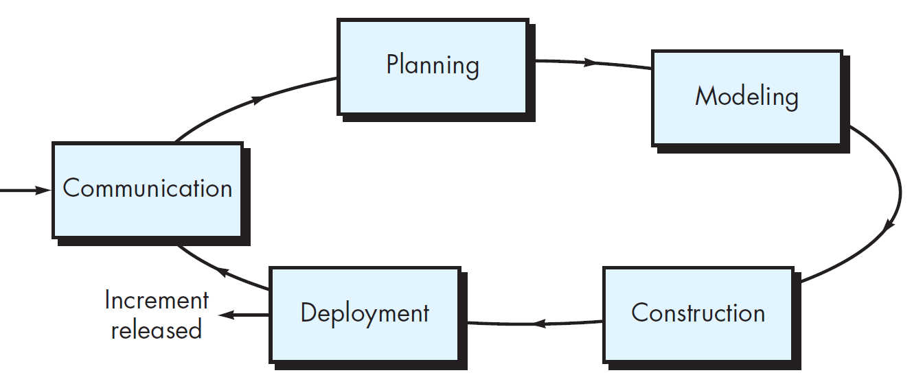
Different types of process flows
Evolutionary process flow
Executes the activities in a “circular” manner
Each circuit through the five activities leads to a more complete version of the software

Slide 20
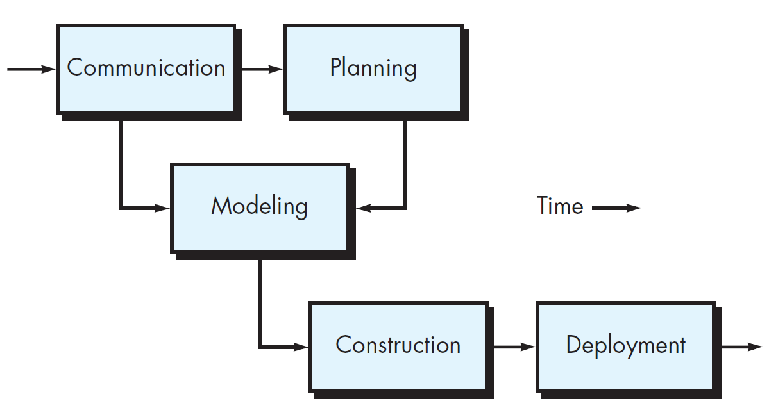
Different types of process flows
Parallel process flow
Executes one or more activities in parallel with other activities

Slide 21

Discussion
Discuss the differences among the various process flows discussed now.
Can you identify types of problems that might be applicable to each of the generic flows described?
(A) LINEAR
(B) ITERATIVE
(D) PARALLEL
(C) EVOLUTIONARY

Slide 22
Defining a framework activity

Slide 23
Question
What actions are appropriate for a framework activity, given the nature of the problem to be solved, the characteristics of the people doing the work, and the stakeholders who are sponsoring the project?

Slide 24
Defining a framework activity for a small project
For a small software project requested by one person (at a remote location) with simple, straightforward requirements, the communication activity might encompass little more than a phone call or email with the appropriate stakeholder
Therefore, the only necessary action is phone conversation, and the work tasks (the task set ) that this action encompasses are:
Make contact with stakeholder via telephone.
Discuss requirements and develop notes
Organize notes into a brief written statement of requirements
Email to stakeholder for review and approval

Slide 25
For a complex project?
If the project was considerably more complex with many stakeholders, each with a different set of (sometime conflicting) requirements, the communication activity might have six distinct actions
inception, elicitation, elaboration, negotiation, specification, and validation
Will see them in detail later…
Each of these software engineering actions would have many work tasks and a number of distinct work products

Slide 26
Identifying a task set

Slide 27
Group exercise in the class – (15 mins)
Suppose Amrita is developing a new university management system (AUMS). Your group has been given chance to develop the same. Identify the task set associated with this project.
AUMS should include
Leave management (for staff)
Employee Management
Student management
Any other functionalities as appropriate for a campus

Slide 28
Sample output
Make a list of stakeholders for the project.
Interview each stakeholder separately to determine overall wants and needs
Build a preliminary list of functions and features based on stakeholder input.
Schedule a series of facilitated application specification meetings.
Conduct meetings.
Produce informal user scenarios as part of each meeting.
Refine user scenarios based on stakeholder feedback.
Build a revised list of stakeholder requirements.
Use quality function deployment techniques to prioritize requirements.
Package requirements so that they can be delivered incrementally.
Note constraints and restrictions that will be placed on the system.
Discuss methods for validating the system

Slide 29
Summary
A generic process model for software engineering encompasses a set of framework and umbrella activities, actions, and work tasks
Each of a variety of process models can be described by a different process flow
a description of how the framework activities, actions, and tasks are organized sequentially and chronologically

Slide 30
15CSE313 Software Engineering
Lecture 4-5
Dr C.Arunkumar
Assistant Professor (Sr.Gr), Dept of Computer Science and Engg
Amrita Vishwa Vidyapeetham, Coimbatore

Slide 31
Generic View of the Process
Pressman R S, Bruce R.Maxim, “Software engineering - A Practitioner’s Approach”, Eighth Edition, Tata McGraw-Hill, 2014
Chapter 3: 3.1, 3.2, 3.3, 3.4

Slide 32
Recap
Nature of Software
The Changing Nature of Software
Software Engineering Definition
The Software Process
Generic Process Model
Defining a framework activity
Identifying a task set

Slide 33
Topics Covered
Topic | Text Book Reference
Process Patterns | 3.4

Slide 34
Process Patterns

Slide 35
Process pattern
Describes a process-related problem that is encountered during software engineering work, identifies the environment in which the problem has been encountered, and suggests one or more proven solutions to the problem
In other words
Provides you with a template - a consistent method for describing problem solutions within the context of the software process

Slide 36
Process pattern
By combining patterns, a software team can solve problems and construct a process that best meets the needs of a project
Patterns can be defined at any level of abstraction
In some cases, a pattern might be used to describe a problem (and solution) associated with a complete process model (e.g., prototyping)
In other situations, patterns can be used to describe a problem (and solution) associated with a framework activity (e.g., planning ) or an action within a framework activity (e.g., project estimating)

Slide 37
Template for describing a process pattern
Pattern Name. The pattern is given a meaningful name describing it within the context of the software process (e.g., TechnicalReviews )
Forces. The environment in which the pattern is encountered and the issues that make the problem visible and may affect its solution

Slide 38
Template for describing a process pattern
Type. The pattern type is specified.
Stage pattern —defines a problem associated with a framework activity for the process. Since a framework activity encompasses multiple actions and work tasks, a stage pattern incorporates multiple task patterns (see the following) that are relevant to the stage (framework activity). An example of a stage pattern might be EstablishingCommunication . This pattern would incorporate the task pattern RequirementsGathering and others

Slide 39
Template for describing a process pattern
Task pattern —defines a problem associated with a software engineering action or work task and relevant to successful software engineering practice (e.g., RequirementsGathering is a task pattern).
Phase pattern —define the sequence of framework activities that occurs within the process, even when the overall flow of activities is iterative in nature. An example of a phase pattern might be SpiralModel or Prototyping

Slide 40
Template for describing a process pattern
Initial Context. Describes the conditions under which the pattern applies. Prior to the initiation of the pattern: (1) What organizational or team-related activities have already occurred? (2) What is the entry state for the process? (3) What software engineering information or project information already exists?
For example, the Planning pattern (a stage pattern) requires that (1) customers and software engineers have established a collaborative communication; (2) successful completion of a number of task patterns [specified] for the Communication pattern has occurred; and (3) the project scope, basic business requirements, and project constraints are known

Slide 41
Template for describing a process pattern
Problem. The specific problem to be solved by the pattern.
Solution. Describes how to implement the pattern successfully. This section describes how the initial state of the process (that exists before the pattern is implemented) is modified as a consequence of the initiation of the pattern.
It also describes how software engineering information or project information that is available before the initiation of the pattern is transformed as a consequence of the successful execution of the pattern.

Slide 42
Template for describing a process pattern
Resulting Context. Describes the conditions that will result once the pattern has been successfully implemented. Upon completion of the pattern: (1) What organizational or team-related activities must have occurred? (2) What is the exit state for the process? (3) What software engineering information or project information has been developed?
Related Patterns. Provide a list of all process patterns that are directly related to this one. This may be represented as a hierarchy or in some other diagrammatic form. For example, the stage pattern Communication encompasses the task patterns: ProjectTeam, CollaborativeGuidelines, ScopeIsolation, RequirementsGathering, ConstraintDescription, and ScenarioCreation.

Slide 43
Template for describing a process pattern
Known Uses and Examples. Indicate the specific instances in which the pattern is applicable. For example, Communication is mandatory at the beginning of every software project, is recommended throughout the software project, and is mandatory once the Deployment activity is under way.

Slide 44
Template in nutshell
Pattern Name
Forces
Type
Initial Context
Problem
Solution
Resulting Context
Related Patterns
Known Uses and Examples

Slide 45
Discussion
A common problem during communication occurs when you encounter two stakeholders who have conflicting ideas about what the software should be. That is, you have mutually conflicting requirements . Develop a process pattern (this would be a stage pattern) using the template that addresses this problem and suggest an effective approach to it

Slide 46
Why Process patterns?
Process patterns provide an effective mechanism for addressing problems associated with any software process
The patterns enable you to develop a hierarchical process description that begins at a high level of abstraction (a phase pattern)
The description is then refined into a set of stage patterns that describe framework activities and are further refined in a hierarchical fashion into more detailed task patterns for each stage pattern.
Once process patterns have been developed, they can be reused for the definition of process variants—that is, a customized process model can be defined by a software team using the patterns as building blocks for the process model

Slide 47
Summary of Chapter 3
A generic process model for software engineering encompasses a set of framework and umbrella activities, actions, and work tasks
Each of a variety of process models can be described by a different process flow
a description of how the framework activities, actions, and tasks are organized sequentially and chronologically
Process patterns can be used to solve common problems that are encountered as part of the software process

